Slide 1
Curriculum Information
Bright Elementary School

Slide 2

Objective: The purpose of presentation is to inform parents on the expectations of the Indiana Academic Standards, what instructional strategies teachers are using to teach these standards, and the assessment measures used to determine students’ level of understanding.

Slide 3
Sunman-Dearborn Community School Corporation
Mission: Our mission is to provide a safe, innovative, and challenging environment designed to prepare students for their future through Stewardship, Data-Driven Decision Making, Collaboration, Shared Leadership, and Commitment.
Vision: Reflecting on our core values of stewardship, data driven decision making, collaboration, shared leadership, and commitment the vision of Sunman-Dearborn Community Schools is: Surpassing expectations and inspiring excellence in every student, every day.
Bright Elementary School
Mission Statement: Bright Elementary provides opportunities for quality education. Staff and parents cooperate to maintain a secure learning environment and instill the desire to become kind, responsible, lifelong learners.

Slide 4
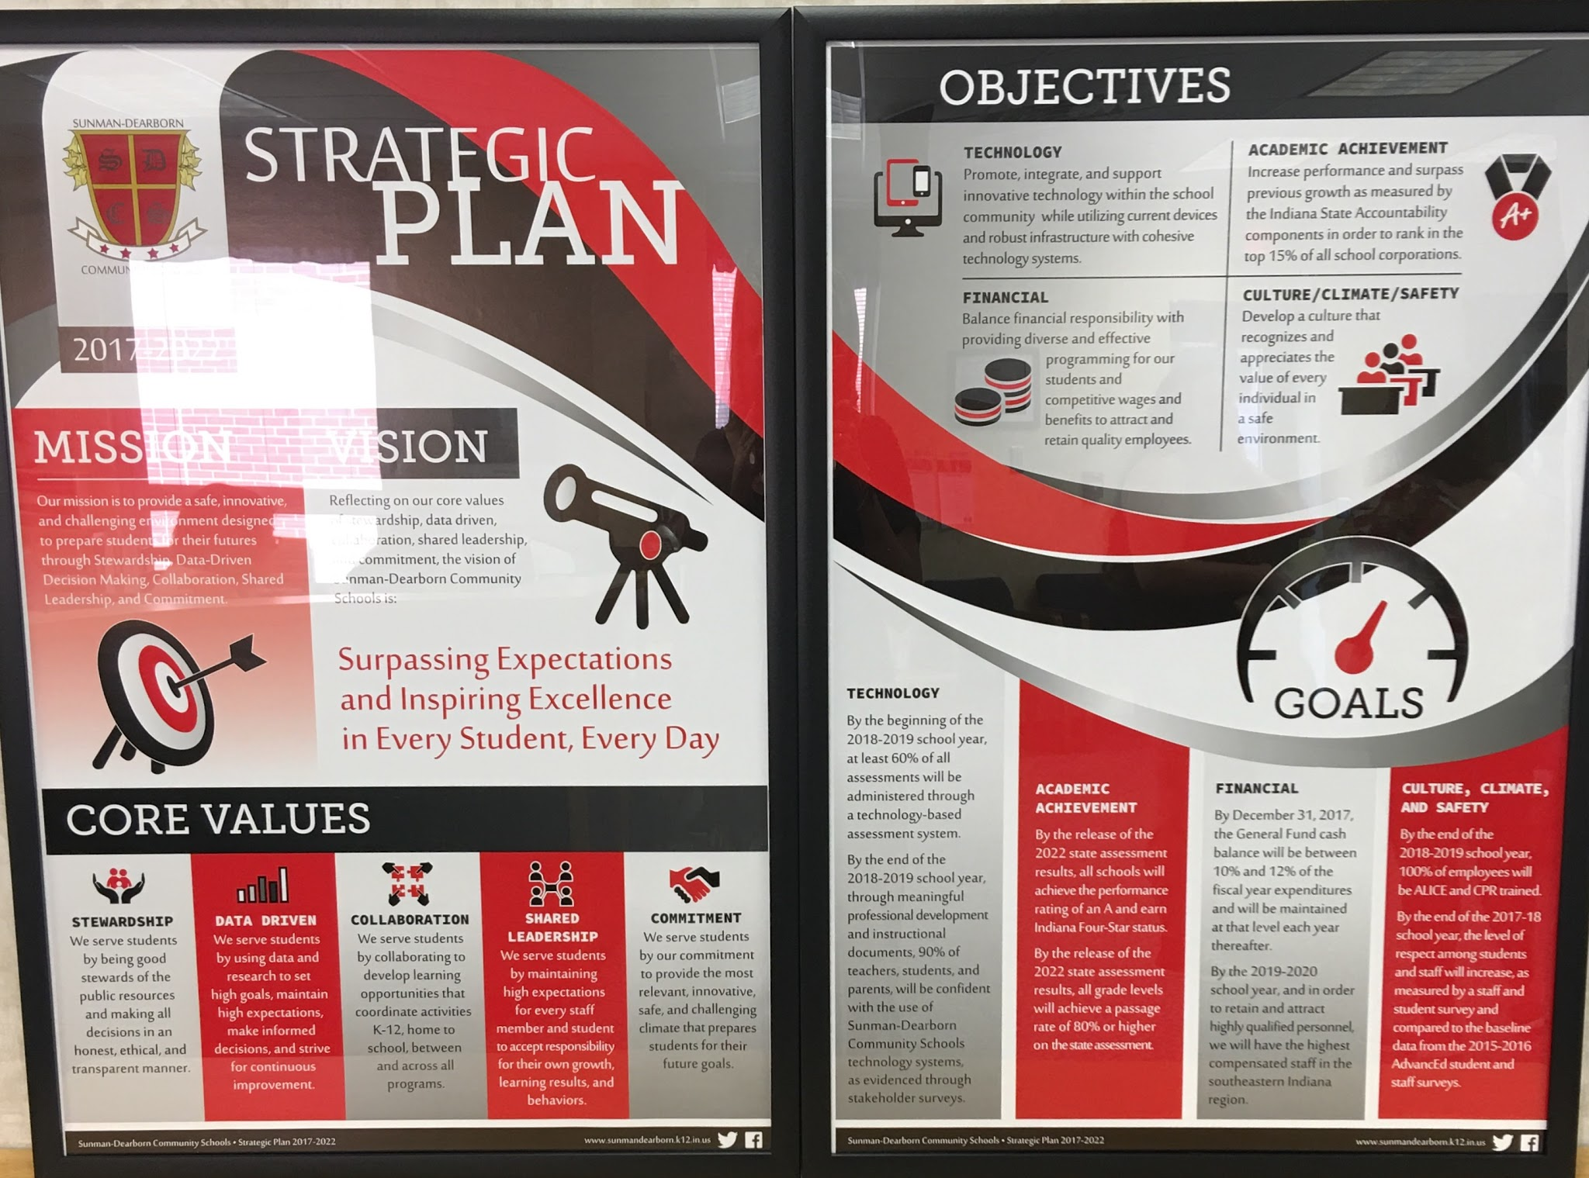
*You can find these posters hanging in all classrooms and in the common areas of BES.

Slide 5

Indiana Academic Standards
“Standards outline what students need to know, understand, and be able to do.”
In April of 2014, the Indiana State Board of Education approved the adoption of new standards for English/Language Arts and Mathematics. The science standards were adopted in the spring of 2016. These new standards are the result of a process designed to identify, evaluate, synthesize, and create high-quality, rigorous standards for Indiana students. They have been validated as college and career ready so students who successfully master these objectives by the time they graduate from high school will be ready to go directly into the workplace or a postsecondary educational opportunity without the need of remediation. Academic standards are benchmark measures that define what students should know and be able to do at specified grade levels beginning in kindergarten and progressing through grade twelve. The standards are promulgated as state regulations.
To check out the standards for each subject area and grade level, refer to the Indiana Department of Education website. http://www.doe.in.gov/standards

Slide 6
Vertically Aligned Standards
This is the same number sense math standard K-5th grade.
K.NS.1: Count to at least 100 by ones and tens and count on by one from any number
1.NS.1: Count to at least 120 by ones, fives, and tens from any given number. In this range, read and write numerals and represent a number of objects with a written numeral.
2.NS.1: Count by ones, twos, fives, tens, and hundreds up to at least 1,000 from any given number.
3.NS.1: Read and write whole numbers up to 10,000. Use words, models, standard form and expanded form to represent and show equivalent forms of whole numbers up to 10,000.
4.NS.1: Read and write whole numbers up to 1,000,000. Use words, models, standard form and expanded form to represent and show equivalent forms of whole numbers up to 1,000,000.
5.NS.3 and 4: Recognize the relationship that in a multi-digit number, a digit in one place represents 10 times as much as it represents in the place to its right, and inversely, a digit in one place represents 1/10 of what it represents in the place to its left. Explain patterns in the number of zeros of the product when multiplying a number by powers of 10, and explain patterns in the placement of the decimal point when a decimal is multiplied or divided by a power of 10. Use whole-number exponents to denote powers of 10.

Slide 7
District-Wide Initiatives
Technology Integration
Sunman-Dearborn Community School Corporation has invested in increasing technology access and use in all five schools this school year. The operating system has been upgraded, devices added such as Chromebooks and projectors, and we hired technology coaches for teachers to use as resources. Teachers will attend technology professional development and students in grades K-12 will take Digital Citizenship courses throughout the school year.
Communication
The district communicates with students, parents, and the community in several ways including Twitter, monthly Fly Pod webcasts on WCPO, and monthly school board meetings. Follow Dr. Jackson, Superintendent, on Twitter
@SDCS_SUPER#SDLearningToLead
Pacing Guides and Common Assessments
Teachers and administrators worked with curriculum consultants the past few years to create and implement pacing guides and common assessments for all grade levels. The pacing guide are meant to guide instruction and allow all teachers in a grade level across the district to be on the same concepts at the same time. This promotes collaboration and the ability to administer common grade level assessments. The data from common assessments allows teachers to compare data across the grade level to guide instruction and best meet the needs of all students.

Slide 8
School-Wide Initiatives
Panther Promise
Professional Learning Communities
Our school has several staff committees to improve the culture, learning environment, and instruction at BES. The committees include: School Leadership Team, PBIS-Panther Promise, Technology, Safety, MTSS, and Social.
Communication
BES has a website, Twitter, Facebook and monthly newsletters. Teachers also communicate to parents by calling, sending emails, and/or notes. Students in grades K-2 use take-home folders and grades 3-5 use agenda books for homework, discipline records, and school to home correspondences.
A group of teachers worked together to develop a school-wide, positive behavior system for BES. This system establishes clear expectations and consequences for students and staff members. The Panther Promise is for common areas of the school. For more information and for the procedure handbook, please refer to the school’s website.
The school motto is:
Panther Promise: I will be ready to learn, be respectful, be responsible and safe!

Slide 9
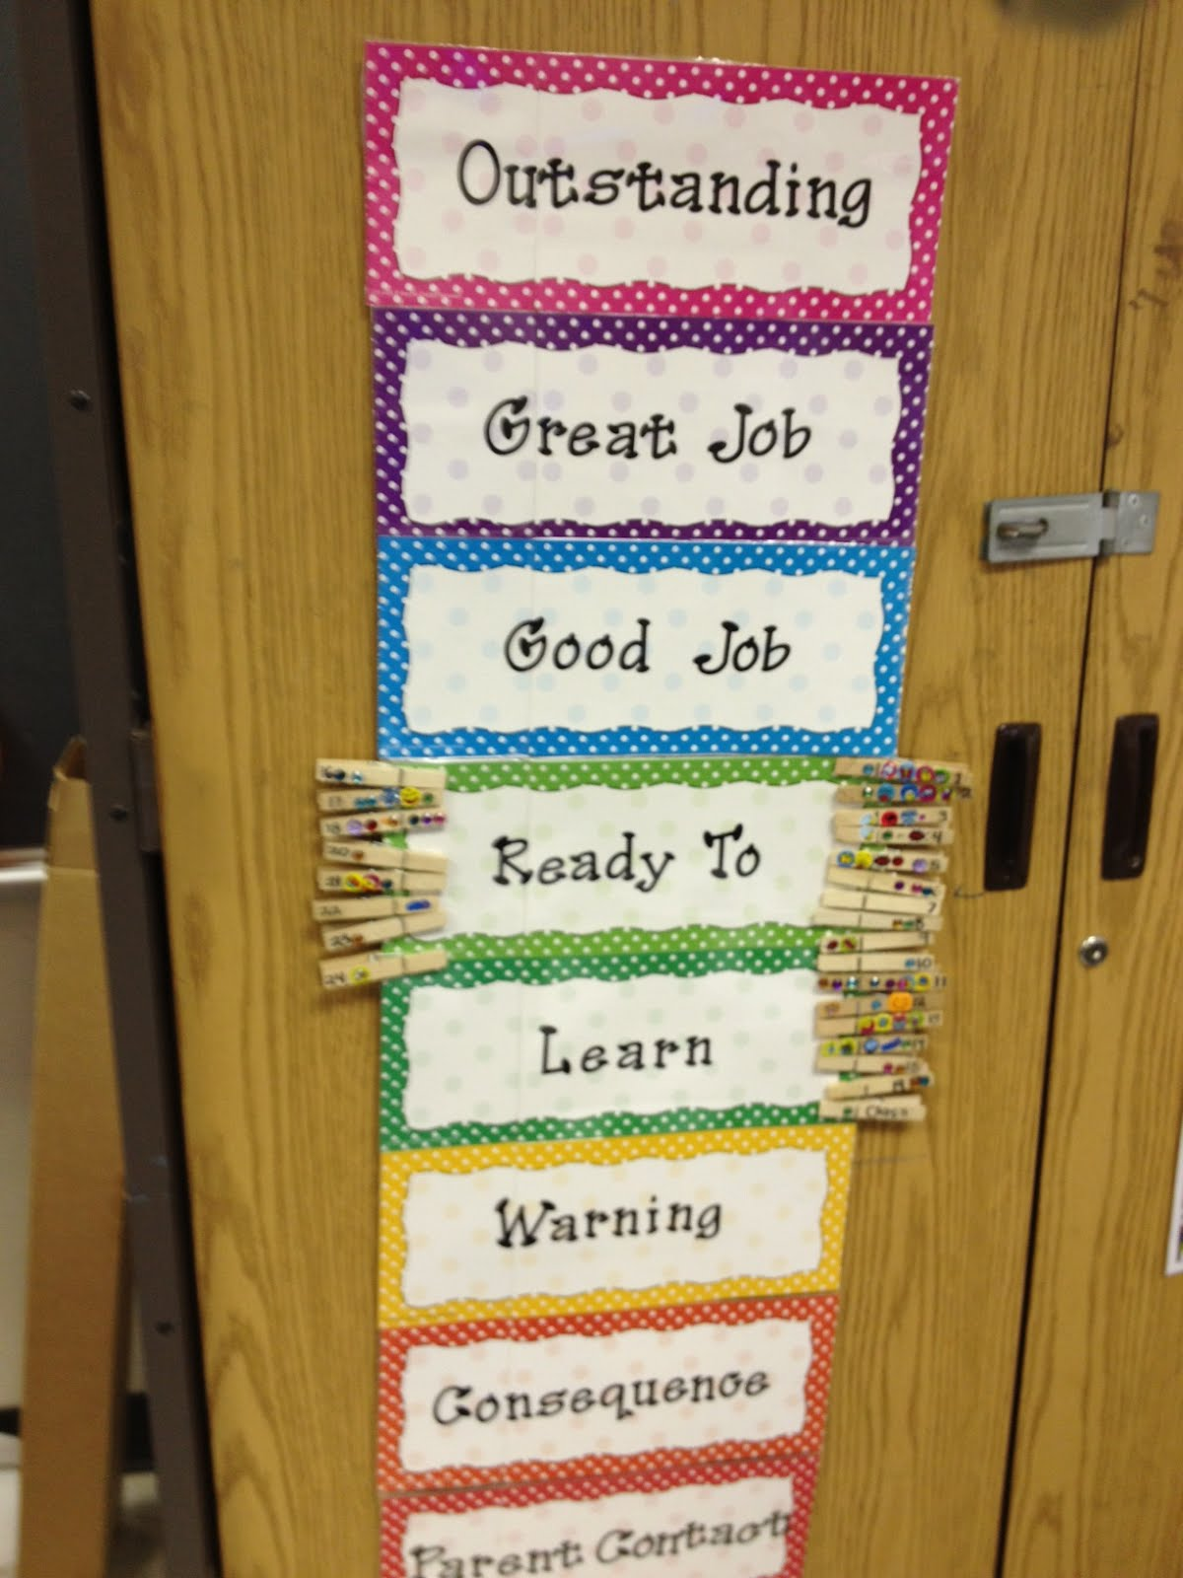
Classroom Discipline
The Panther Promise is the school-wide discipline system for all common areas such as the cafeteria, restrooms, playground, computer labs, science labs, and hallways. To maintain teacher autonomy, individual teachers have a discipline system within their own classroom. Classroom discipline systems vary from teacher to teacher and grade to grade. All classrooms have a discipline system, including clear expectations, procedures, and consequences. Many classrooms use the clip chart system.

Slide 10
Bright Elementary School Staff
Administrators: Dr. Andrew Jackson, Superintendent Kelly Roth, Principal | Counselor: Abby Ruwe
Office Staff: Martha Rosenberger and Jamie Shartzer School Nurse: Sue Simpson Librarian: Lisa Hempfling | Custodians: Ed Osman, Brad Callaway, Mark O’Shaughnessy,
Cafeteria Staff: Carolyn O’Shaughnessy, Food Service Director Tina Clary, Donna Crague, Cathy Kolb, Janet Joyce, Tonya Collins, Mary Ann Rolfes | Teachers: See coming slides Assistants: Stephanie Vaught, Vickie Newport, Kelly Lewis, Angie Wagner, Sandra Origer, Rebecca Wulzerbacher, Ronda Hall, Jami Brandenburg, Teresa Bolinger, Angela Block, Patty Bourquein, Katie Ravenna, Rita Steins, Heather Borntrager, Jamie Callaway, Nicole Walden, Amber Humble, Renee McCann, Kaila Earehart, Minnie Carson, Christa Losciavo, Pink Bates

Slide 11

Special Area: PE
All students in grades K-5 attend PE class one time per week.
Teacher: Lisa Tyler
Goal: To provide students with the knowledge and skills necessary for the development of a healthy and active lifestyle.
Process:
  Skill development for K-2 (throwing, catching, jump rope, sportsmanship, etc.)
  Continued focus on locomotor (skip, gallop, walk, etc.), non-locomotor (bend, straighten, twist, etc. )skills throughout grade levels
  Integrating new activities (roller skating, dodgbee, and gaga) and life long activities (bowling, basketball, volleyball, etc.) to promote interest in being active
  Heavy focus on being active and the benefits of a healthy lifestyle
Students are expected to bring proper shoes to each class.
Notes:
Billy

Slide 12


Special Area: Music
All students in grades K-5 attend music class one time per week.
Teacher: Maria Keck
“Music, along with the other fine arts, is a critical part of both society and education. Through participation in music, individuals develop the ability to think creatively as they work both individually and with others to develop skills, gain understanding of musical ideas, and produce musical products via performance, composition, and improvisation. These abilities to think critically and creatively, communicate effectively, and collaborate are ones that enable today’s students to navigate future professional environments successfully as they become life-long music participants.”
(Introduction to the 2018 Indiana Music Education Standards)
Our music curriculum is guided by the Indiana State Standards for Music. Those standards can be summarized in the following four categories:
Connect Students explore the relationship between music and their personal experience, as well as its relationship to history and culture, to the other arts, and to disciplines outside of the arts. | Listen and Respond Students describe, interprete, analyze, and evaluate music and its elemental components, and through this deeper understanding, explore ways to respond to music through movement. | Perform Students develop and utilize rote memory, as well as the reading of written musical notation to sing and play instruments, alone and with others, using proper technique and performance etiquette. | Create Students create a varied repertoire of music by improvising, audiating (internalizing), and composing or arranging music using traditional or non-traditional music notation.
Notes:
Julie W

Slide 13





Special Area: Art
All students in grades K-5 attend art class one time per week.
Teacher: Carla Daugherty
Goal : To provide students with the knowledge, skills, and confidence necessary for creative development in visual arts.
Processes :
  Students will be introduced to new mediums and explore using them.
  Students will learn the elements of art and principles of design and how to apply them to 2D and 3D art.
  Students will work on improving their craftsmanship from year to year.
  Students will be able to be creative while also adhereing to basic guidelines.
  Students will learn the proper and safe use of art tools and materials, and be respectful of their own and other’s art pieces.
  Students will learn how to critique a piece of artwork (their own and someone else’s).
Students are expected to bring necessary materials to class depending on what the project requires
(pencil, variety of coloring supplies, and/or art shirt).

Slide 14

Special Area: Library
All students in grades K-5 attend library class one time per week.
Librarian: Lisa Hempling
Students will be able to check out a book each week.
Mrs. Hempfling shares stories and reinforces literacy concepts through active discussions.
BES will host book fairs in the Fall and Spring where students can purchase books.

Slide 15

Special Area: Computer
All students in grades K-5 attend computer class one time per week.
Teacher: Grade Level Assistants
Students will learn basic keyboarding skills, how to conduct research, create word processing and digital presentations, take computer-based assessments, and more. All students will participate in a Digital Citizenship program. Those lessons will be taught by classroom teachers.

Slide 16

Kindergarten
Teachers:
Kristen Hallahan
Shawna Leising
Diana Coffman
Karen Schebler
Goals:
To master all kindergarten skills in math, reading, writing, science, and social studies.
Develop positive social skills
Becoming lifelong learners

Slide 17
Kindergarten
Resources:
Pearson My View Reading
My Math Textbook
Pearson science
Digital Citizenship
Scholastic News
Zaner Bloser Handwriting
Educational websites
Instructional Strategies:
Daily Work Stations
Small Group Work
MTSS
LIPS techniques
Orton-Gillingham techniques
Songs and music
Large/fine motor activities

Slide 18
Kindergarten
Assessments:
Midterms and report card sent home each quarter
Quarterly Reading/ Math/Science/Social Studies Assessments
NWEA Math Assessments (B, M, E)
Fountas & Pinnell (Reading)- (B, M, E)
Observations
Dyslexia Screener
Homework Expectations:
Read DAILY (Fluency Folders sent home weekly)
Play games as a family
Review Sight Words daily
Math Textbook homework
Homework Calendar

Slide 19
KindergartenReport card and grading:
All kindergarten teachers in the district use a Standards-Based Grading system. Throughout each quarter we will collect data of each student’s achievement through student work, performance tasks, observations, and end of quarter assessments. Achievement is identified through a 3, 2, and 1 number system on work that is sent home, as well as, quarterly report cards.
A “3” shows that the student consistently meets and demonstrates mastery of current grade level expectations.
A “2” shows that a student has not yet mastered the grade level expectation, but is at the beginning stages of understanding the skill. The student is demonstrating understanding some of the time., but not consistently more than 90% of the time.
A “1” shows that a student is not meeting current grade level expectations. The student can only demonstrate understanding 50% or less of the time.

Slide 20
Kindergarten
Guest Speakers/ Special projects:
Meterologist in Spring
Disabilities Awareness in Spring
Monthly Librarian Visits from North Dearborn/Lawrenceburg Public Library
Field Trips:
*Field Trips could change
Fall:
Wendel Farms
Spring
Cincinnati Zoo

Slide 21

1st Grade
Teachers:
Connie Betts
Rebecca Lail
(Substitute-Titus Luckhaupt)
Kim Wedding
Goals:
Students will be able to decode, read, and comprehend grade appropriate material across the curriculum.
Students will become fluent with their basic addition and subtraction facts.
Students will learn how to be a good citizen in their school and their community.
Students will engage in science through reading, inquiry, and technology.

Slide 22
1st Grade
Resources:
Pearson My View Reading
My Math Textbook
My World Social Studies
Scholastic News
Interactive Science
Instructional Strategies:
Pre-test to determine prior knowledge
Differentiate by providing activities that challenge all students.
Provide purpose for learning by making connections to student’s experiences and the world around them
Engage students in meaningful activities that promote understanding
Provide students with the opportunity to share what they have learned through these instructional activities
Post-test to determine mastery of skills and plan for interventions and differentiation

Slide 23

1st Grade
Homework:
Nightly Reading Assignments
(Take-Home books, Reading book)
Sight Word and Spelling Practice
Math Homework and +/- flashcards
Assessments:
Quarterly Reading and Math Assessments
End of Quarter Common Assessments
NWEA (Math) -3 times per year
Fountas & Pinnell (Reading)- 3 times per year
Dyslexia Screener (Beginning of 1st grade)
All 1st grade teachers in the district use a Standards-Based Grading system. Throughout each quarter we will collect data of each student’s achievement through student work, performance tasks, observations, weekly tests, and end of quarter assessments. Achievement is identified through a 4,3,2, and 1 number system on work that is sent home, as well as, quarterly report cards.
A “4” shows that the student consistently exceeds mastery above grade level expectations.
A “3” shows that a student consistently meets and demonstrates mastery of current grade level expectations.
A “2” shows that a student is emerging and approaching the benchmark.
A “1” shows that a student is not meeting current grade level expectations. The mastery level is anything scored at 75% or higher.
Notes:
Glenda

Slide 24

1st Grade
Guest Speakers/
Special projects:
Miss Molly Recycling Presentation from Dearborn County Recycling
Jennifer Ketchmark/WCPO Meteorology Presentation
Time Line Project
Field Trips:
*Field Trips could change
1st semester: Cincinnati Museum
2nd semester: TBD

Slide 25
2nd Grade
Teachers:
Emily Thomison
Michelle Hofer
Lauren Foster
Tammy Marro
Goals:
We strive to help students increase their number sense, become more fluent with their math facts, and understand how numbers relate to each other. (EXAMPLE: fact families 3+7=10, 7+3=10, 10-3=7, 10-7=3)
Students will have a basic understanding of our community and the services provided.
Students will be able to read and comprehend a grade level text fluently and apply this to other subject areas.
Notes:
Barb

Slide 26
2nd Grade
Resources:
Pearson My View Reading Series
Pearson Social Studies and Science
Scholastic News
Guided Math
Instructional Strategies:
Small groups to differentiate instruction to meet each student’s needs
CUBES for problem solving
RACE for a constructed response to questions
Promote learning through engaging and meaningul activities
Reteaching content to reach mastery of skills
Notes:
Barb

Slide 27
2nd Grade
Homework:
Nightly Reading
Study Spelling and Vocabulary
Practice math facts
Assessments:
NWEA Math
Fountas & Pinnell Benchmark Assessment
Quarterly Subject-Area Assessments
Dyslexia Screener
Homework Expectations:
Homework is designed so that students can and should get help from an adult. We expect homework to be checked over with the child and returned with the correct answers.
Students should always plan to read, practice vocabulary and spelling words, and practice math facts.
20-30 minutes each night is a reasonable amount of time for second grade.
Notes:
Kendra

Slide 28
2nd Grade
Guest Speakers/
Special Projects:
Little Entrepreneur Project
Animal Research Project
Fire Safety
Balloons Over Broadway
Dr. Seuss Research & Play
Mother’s Day Spa
Christmas Around the World
Field Trips:
*Field Trips could change
iSpace
The Place
Notes:
Jolynn

Slide 29
3rd Grade
Teachers:
Shelly Koth
Connie Turner
Rachel Strobl
Kim Lloyd
Goals:
Increase students’ basic math fact automaticity
Improve the quality of students’ constructed response answers
Increase students’ self- sustained reading stamina
Apply problem solving strategies in math
Notes:
Melissa

Slide 30
3rd Grade
Resources:
Digital Citizenship Curriculum
Novels
Pearson My View Reading Series
McGraw Hill Math Series
Pearson Social Studies and Science
Instructional Strategies:
Hands On Activities
RACE method for constructed response questions
Small grouping for reading and math
Math fact fluency practice
CUBES method for problem solving
Notes:
Jamie

Slide 31
3rd Grade
Assessments:
IREAD3
ILEARN
Quarterly assessments in English Language Arts, Writing, Math, Social Studies
NWEA Reading, Math, Language assessments (BOY, MOY, EOY)
Homework Expectations:
The purpose of homework is to reinforce a previously presented skill. Please make sure to assist your child and ensure that he/she is doing the homework correctly.
Students should be reading for 15 - 20 minutes each night.
Practice basic math facts.

Slide 32
3rd Grade
Special projects:
Invention project
Graphing project
Field Trips:
*Field Trips could change
Cincinnati Reds Hall of Fame Museum and Ballpark tour
AG Day-Presented by Dearborn County- Purdue Extension: This field trip exposes students to different agricultural and livestock resources from our area.

Slide 33
4th Grade
Teachers:
Megan Myers
Beth McClamroch
Caity Jo Odar
Patty Pierce
Goals:
Students will be citing evidence to support answers.
Instead of learning to read, students shift to reading to learn, especially in areas of Science and Social Studies.
Students will become more independent and take on more responsibility with their learning. They still need guidance from parents and teachers however they need to take ownership of their learning.
Students will be able to explain math computation and reasoning.
Notes:
Sharon

Slide 34
4th Grade
Resources:
Pearson My View Reading Textbook
My Math Textbook
Junior Great Books
Science and Social Studies Textbooks
Instructional Strategies:
RACE Response Format
Differentiated Instruction for Reading and Math using Flexible Grouping
Kinesthetic Learning strategies
Visualizing Verbalizing
Self Monitoring and Performance feedback through Data Folders
Reading Centers

Slide 35
4th Grade
Guest Speakers-
Think Smart Stay Safe
Special Projects:
Famous Hoosier
Operation Christmas Child
Engineering Day with Cincinnati State students
Field Trips:
Fall trip to Franklin County Fairgrounds for the Antique Machinery Show -- meets Indiana History standards
Spring trip to the Cincinnati Zoo -- meets fourth quarter Science standards

Slide 36
4th Grade
Assessments:
ILEARN
Quarterly assessments in English Language Arts, Writing, Math, Social Studies, Science
NWEA Reading and NWEA Math assessments (BOY, MOY, EOY)
Homework Expectations:
Independence, Organization and Responsibility
Reading AR each night
Students should only have a maximum 40 minutes of homework in 4th grade

Slide 37
5th Grade
Teachers:
Chris Vennemeier
Gretchen Ernst
Brooke Stenger
Angie Neff
Goals:
Foster organizational skills and agenda usage to be independent learners
Practice and act by the Panther Promise to be role models for younger students.
To empower them with learning tools to become lifelong learners.
Mastery of 5th grade College and Career Ready standards.

Slide 38
5th Grade
Instructional Strategies:
Frameworks to create a constructed response:
Examples: RACE-(restate, answer, cite,
explain)
Phonetics to improve spelling
Use of dictionary and thesaurus to enhance vocabulary:
definitions, parts of speech, synonyms,
antonyms, affixes.
Differentiation to help meet needs of individual students.
Mnemonic devices to aid in remembering.

Slide 39
5th Grade
Assessments:
ILEARN
Quarterly assessments in English Language Arts, Writing, Math, Social Studies, Science
NWEA Reading and NWEA Math assessments (BOY, MOY, EOY)
Homework Expectations
By using the agenda, students become responsible: bringing home what is needed and completing it. This helps them become good communicators between home and school.
Stay organized: putting work in the correct place to bring home and to return to school.
Complete any work not finished at school that is due.
study for tests
Read 20 minutes each night for AR

Slide 40
5th Grade
Guest Speakers/Special projects:
Get Real about Tobacco
Pick a Book
States Project
Field Trips:
*Field Trips could change
Cincinnati Cyclones Day of Science
S-D Middle School visit
ECHS Drama Production

Slide 41
Report Cards
K-standards-based report cards (1,2,3)
1st-standards-based report cards
2nd-letter grades (A, B, C, D, F)
3rd-letter grades
4th-letter grades
5th-letter grades
Report cards vary from grade to grade. Some areas such as specials, citizenship, and handwriting receive O,S,or N grades.
O-outstanding
S-satisfactory
N-needs improvement

Slide 42
Multi-Tiered Systems of Support (MTSS)
Each grade level has at least 30 minutes built into their daily schedule to meet the individual needs of students. If a student has mastered the standards currently being taught for reading or math, that student may receive enriched or advanced lessons from a grade level teacher during MTSS. If a student is on grade level with current concepts being taught in the classroom, they will receive extra practice and reinforcement of skills and learn study skills during MTSS. If a student is struggling with a concept, reinforcement of that reading or math skill will occur during MTSS.

Slide 43
Special Education
Our school district is part of a special education cooperative, ROD, shared by several school districts in Ripley, Ohio, and Dearborn Counties. ROD does special education evaluations, and supports our school with services such as occupational/physical therapy, and vision and hearing assistance for students who qualify.
BES Special Education Teachers:
Melissa Lowe, Katelyn Looney, Nicole Schoenberger, Tiffany Terry, Michelle Paquette

Slide 44
Available Services
* For students who qualify based on state eligibility
Speech Therapy-Michelle Paquette
(articulation,voice, fluency and language remediation)
Occupational Therapy
Physical Therapy
School-based Counseling

Slide 45
High Ability
Sunman-Dearborn Community School Corporation has adopted the School Cluster Group Model (SCGM) to service identified high ability students in the general education classroom. SCGM benefits all students making it easier for teachers to differentiate instruction. All students are given multiple assessments each school year to determine eligibility for high ability services. If you would like more information about high ability, see the handbook on the district website under the info. tab or contact Barb Katenkamp the district High Ability Student Services Coordinator.
www.sunmandearborn.k12.in.us
Notes:
Kelly

Slide 46
School Counseling
Abby Ruwe is the counselor at BES. Some of their roles include facilitating MTSS and special education referral process, providing support to families who are seeking resources or assistance, and providing individual, group, and classroom counseling to students to help them succeed in school.
Notes:
Kevin and Mandy

Slide 47
School Nurse
Sue Simpson is our school nurse. She can provide basic first aid treatment for accidents that occur at school and administer Tylenol, with consent, for low grade fevers that come on at school.
If students need to take medicine at school, please send the medicine in the original container with a note.
Vision screenings are done for students in grades K, 1st, 3rd, 5th, and upon teacher referral. Hearing screenings are done for grades K, 1st, 4th, and upon teacher referral.
Notes:
Kelly-medicine forms are on top of filing cabinet in Nurse Joanie’s office if anyone asks for one

Slide 48
Ways to get involved…
PTO (First Thursday of the month)
Classroom Volunteer
Field Trip Chaperone
Party Volunteer
Lunch Guest
School Board Meetings (second Thursday of the month)

Slide 49
Special School-Wide Functions
*This is a list of things we have done in the past. Functions will vary from year to year.
Special Convocations
Fundraisers
Veteran’s Day
Music Concerts
Movie Nights (PTO)
Spring Carnival (PTO)
Special Areas Showcase

Slide 50
Questions????
Please feel free to contact any staff member with questions about BES Elementary School. Contact information can be found on the school’s website.

